Slide 1
Ansible
Marlo Terr
Notes:
Intro about yourself and what you’ll be speaking about
Mention that the slides are very verbose so that they can easily be referenced for studying or to set up Ansible

Slide 2

How LASP utilizes Ansible
Common Role to configure all VMs
LASP uses a lot of different Linux distributors (different version of RedHat, Ubuntu, and OpenSuse). Common Role needs to work for ALL
Notes:
Standardizing how production vms are configured
Automating the testing process for the Ansible playbook
Ansible playbooks need to work for all of the different linux distributors used at LASP
Not only does automation with Ansible make configuration management scalable but it also makes things more consistent
Easier to debug servers

Slide 3
What’s Ansible and its Benefits?
Automation tool for configuring infrastructure and application deployment.
Example: if you want to update 40 different packages on a weekly basis you can write a playbook that will update them.
Idempotent: You only do things that are needed and repeatable without side effects.
Declarative (not procedural): you write a description of the state you want and Ansible will execute the steps to accomplish this state.
Notes:
Ansible is an automation tool for configuration management and application deployment.
Basically a fancy bash script
Ansible uses playbooks that are written in YAML files to list the modules/tasks that you want performed on your nodes.
What I mean by Ansible being idempotent is that you can run the same task multiple times and it won’t change from the initial application.
Since Ansible is declarative, you just tell it what state you want your node to be in and Ansible to know the steps and dependencies involved in achieving that state.

Slide 4




CI flows with Ansible

Slide 5
How does Ansible work?
Ansible connects to our nodes and pushes out small programs
These programs are resource models of the desired state of the program
Ansible then executes the playbook modules over SSH
Ansible is written in Python
Notes:
Host Linux Ansible. – SSH - > Nodes 1; Nodes 2;

Slide 6
Setting up Ansible
You need Python 2 (at least 2.6)
Install Ansible
RHEL: sudo yum install ansible
Check if you have Ansible installed with the command: ansible --version
Add your Public ssh key to any servers/nodes that you want to run Ansible scripts on.
If you don’t have a key yet generate one: ssh-keygen -t rsa -b 4096

Slide 7
What Ansible can automate
Provisioning:
Set up needed servers for your infrastructure
Maintain already running VMs
Ansible can provision environments that consist of metal servers, are virtualization platforms, or are in the cloud

Slide 8
What Ansible can automate
Configuration Management:
Change the configuration
Start, stop services
Install, update applications
Implement security
I.e. If you have a specific root password for each network, you can check the network and assign a root password accordingly.

Slide 9
What can Ansible automate?
Application Deployment:
Deploy internally developed application to your production systems.
Deploy updates
Spin up a new VM for your application.

Slide 10
Useful modules for application deployment
Some database modules: MongoDB, MySQL, PostgreSQL
Git module
Clone repository onto server
Manage your Node.JS packages with the NPM module.
Notes:
There are tons of different Ansible modules for tasks like a simple installation, cloning a git repository, setting up and managing databases, starting applications, and much much more.

Slide 11
What if Ansible doesn’t have a module that I need?
You can write your own module!
You can write them in any language that returns JSON (Ruby, Python, Bash, etc.)
If you don’t want to write your own Ansible module, there’s a shell module so you can directly execute commands
If you use this, Ansible sometimes thinks that the shell task failed even, if the command went smoothly.
To solve this, you can just specify to ignore errors for that task.

Slide 12
Ansible Vault
Ansible vault is a way to encrypt your playbooks or certain task files or variable files that are used in your playbook.
This is useful for when you need to store sensitive information such as credentials.
Ansible can use variables. If you don’t want to encrypt the whole playbook, you can create variablize all of the things you want to encrypt in one file.
Notes:
At this point in the semester, I think we all know not to commit our AWS credentials to our Repos.
Since you’ll probably have to include some sort of credentials or information you don’t want public in your playbook, you can encrypt it

Slide 13
Configuration after installation
Check to make sure you correctly installed Ansible with the command “ansible --version” (no quotes)
Under the version it will say “configure path: “ and if it’s blank then there’s no configuration file.
Go to /etc/ and make the directory /etc/ansible/ and create the file ansible.cfg
In the ansible.cfg file, add the path to your inventory (aka your hosts)
Ansible should auto-detect that you made an ansible.cfg file
To check to make sure it is up-to-date, run the command “ansible --version” again

Slide 14
Some useful commands
Check to see if Ansible works with the command : sudo ansible -m ping all
To look at the storage information for all of the servers use the command: sudo ansible -m shell -a 'df -h' all
Note: If you cannot ssh into a server, neither can Ansible.
Any nodes that you want Ansible to have access to need to have your public key in the authorized_keys file of the node

Slide 15
Components of a playbook
Header
Hosts the task is for and the user that will be performing the task (i.e. root user).
Tasks
The actions that you want to automate
Handlers
“Notify” actions that are triggered at the end of each block of tasks in a play
Only triggered once even if notified by multiple different tasks.
Notes:
Whether you’re provisioning, configuring, or deploying code, your playbooks will look very similar

Slide 16
How to become a user other than root
hosts: webservers
remote_user: your_username
become: yes
become_user: postgres
Notes:
Sometimes people will create a user just for Ansible

Slide 17
Playbooks can contain multiple plays
- hosts: webserver
remote_user: root
tasks:
name: ….
- hosts: databases
remote_user: root
tasks:
name: ...
Notes:
If you want to perform different tasks on multiple servers this can be done with one playbook.

Slide 18
Playbook example
For the header use: ---
Three dashes
Specify what hosts you want to make this installation on
For all of the hosts: - hosts: all
In order to make this installation, it needs to be done by the root user, so to change users use this command:
become: true
Lastly, define the roles you want to use
In this case, use Basic because this is the directory we created under roles
To run your playbook use the following command:
ansible-playbook -K playbook.yml
-K says to ask for privilege escalation password
Notes:
In the playbook, you want to specify the hosts that you want this installation, the user that should be performing the task, and lastly the tasks themselves.

Slide 19
Demo!
Install/update nano on local host

Slide 20
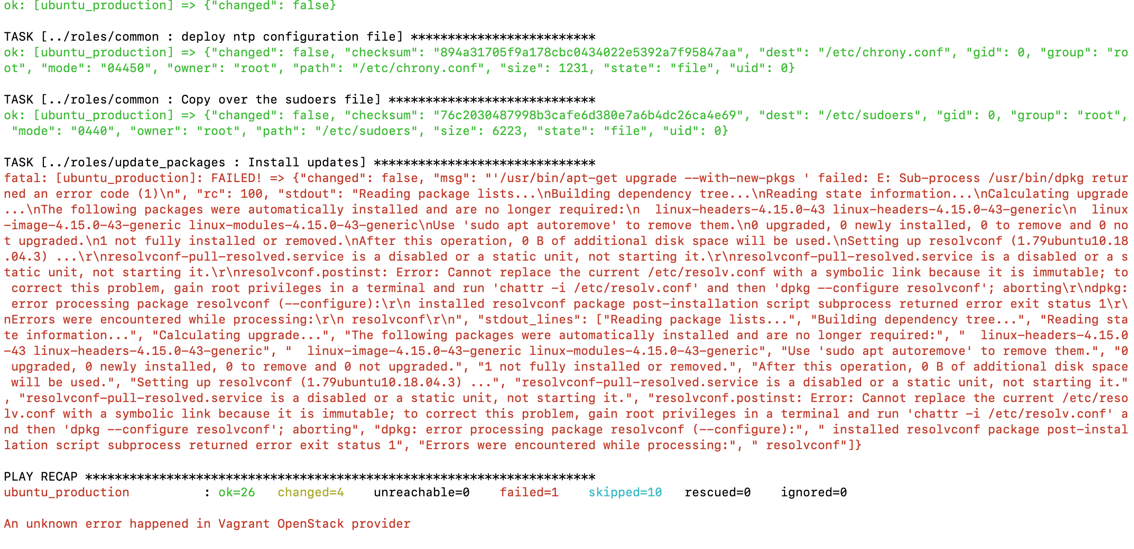
Error Example
Notes:
Resolv.conf problem
This is a really good example because it tells you the problem and offers a solution
In this case, there’s a problem with updates Ansible is trying to use resolved, which is part of the service manager systemd and replace resolvd with a symbolic link.
Ansible

Slide 21
Debugging in Ansible
Best approach is to run your playbook in verbose mode
-v, -vv, -vvv
Once you have an idea of what the error is, you can ssh into the server and try possible solutions.
Once you figured out what works, add those steps prior to the failed task
Utilize Ansible debugger

Slide 22
Please Note!
SPACING MATTERS
One extra space or lack of space can cause errors
If you don’t specify which host to run your playbook on with the tag: -i {ip address} then Ansible will run on ALL of the hosts in your inventory
If your playbook fails during a task, you can figure out a fix for the bug and then re-run the playbook on the same VM and it should get to the buggy task a lot quicker

Slide 23
Running your playbooks with Vagrant
When testing your Ansible playbooks, you want to be able to spin up and break down VMs pretty quickly
Vagrant takes care of a lot of the work that you would otherwise have to do.

Slide 24
How does Vagrant work?
You make a Vagrantfile, where you specify where you want the Ansible playbook to run
This includes having Vagrant spin up a new VM
You can specify as many ansible details as you want, regarding running the playbook
Once the Vagrantfile is setup, it’s as easy as one simple command to start testing the playbook and one simple command to revert the VM to its initial state

Slide 25
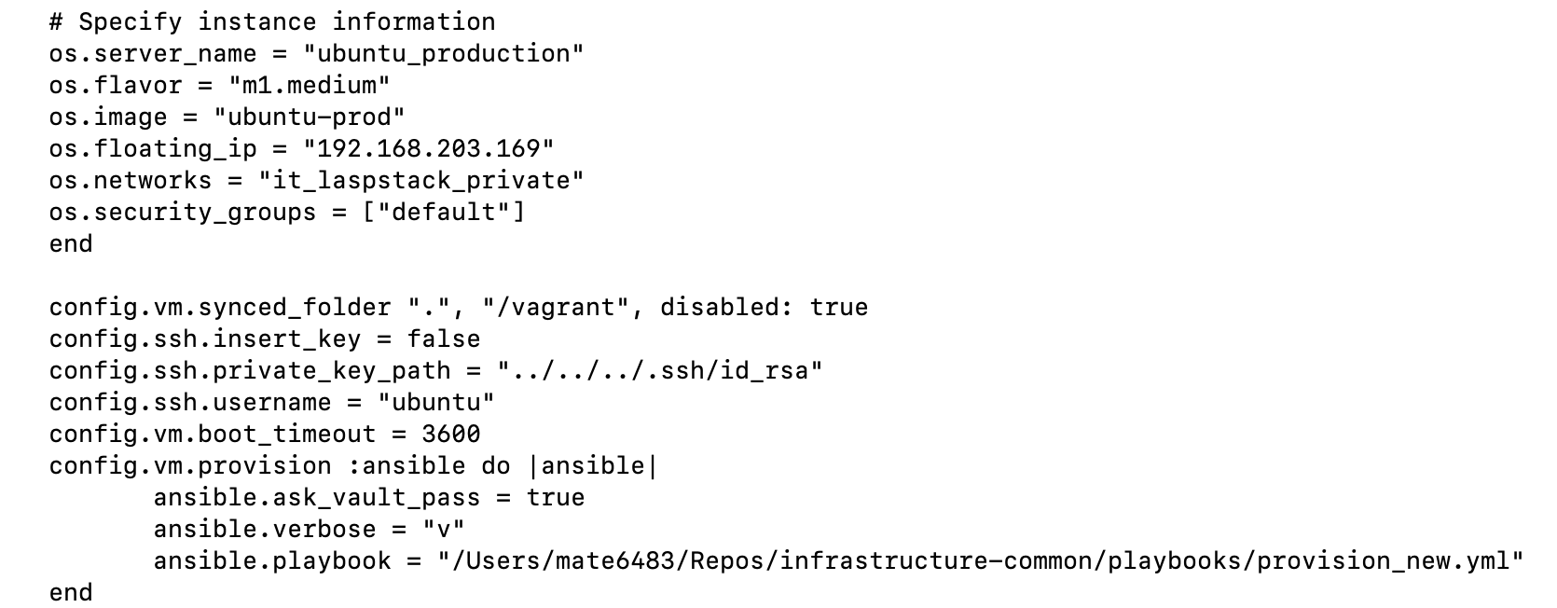
Vagrantfile for Ansible
Openstack example
Specify API tokens for Openstack (not shown)
Say what type of VM you want spun up and all of the Ansible details

